Slide 1
Inserting a key into a B-tree and its Analysis.
By
Mr. AHAMED SHAFEEQ B M
Assistant Professor-Selection Grade
Department of Computer Science & Engineering
M.I.T Manipal

Slide 2
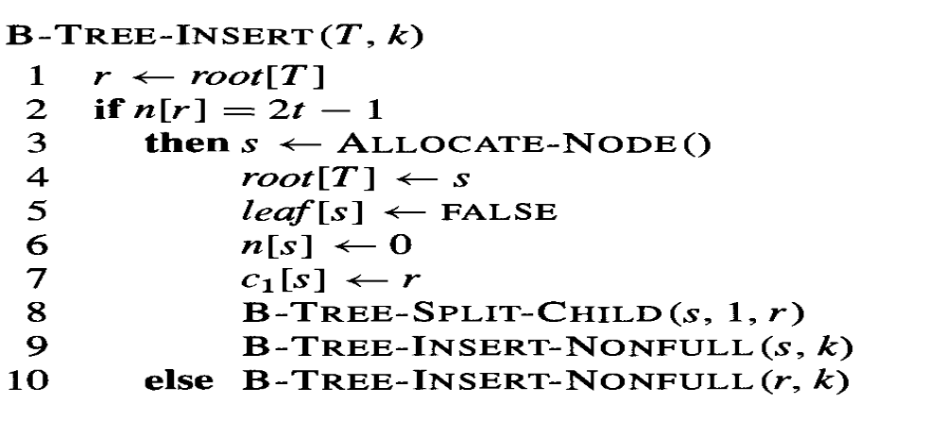
Inserting a key into a B-tree
Insert a key k into a B-Tree of height in a single pass down the tree

Slide 3
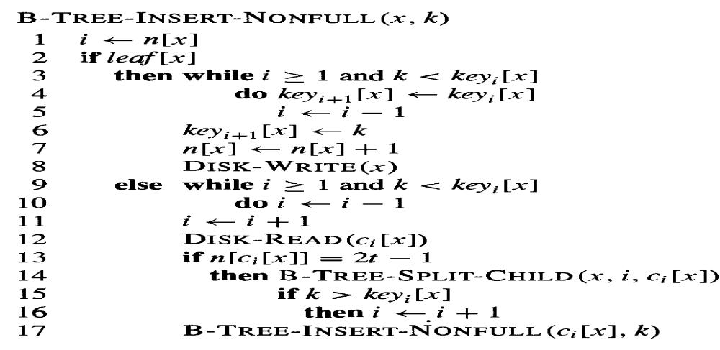
Insertion- nonfull root node

Slide 4



B-Tree construction

Slide 5
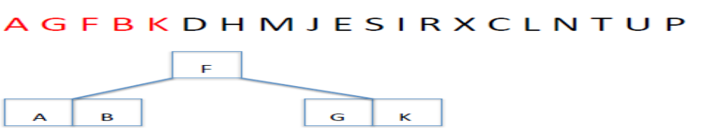
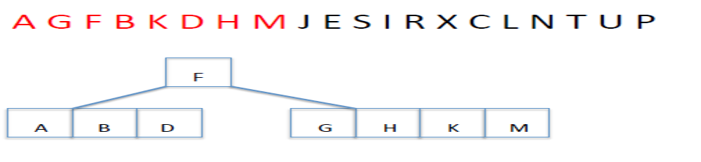
B-Tree construction

Slide 6
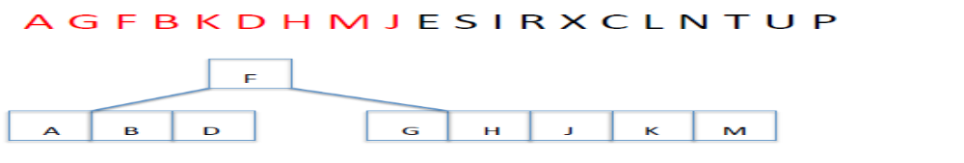
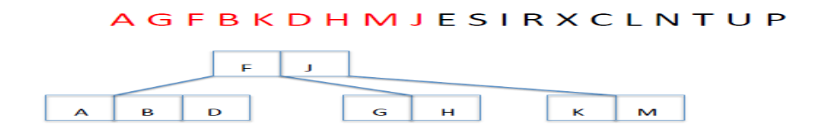
B-Tree construction

Slide 7
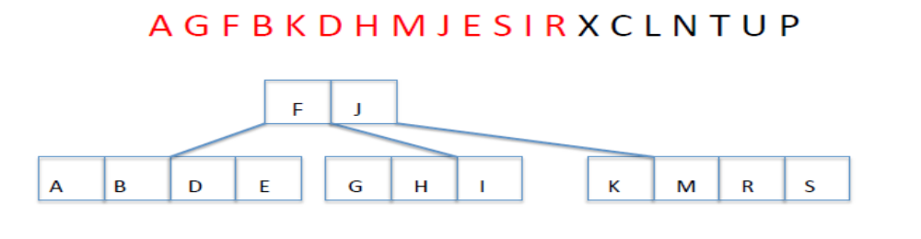
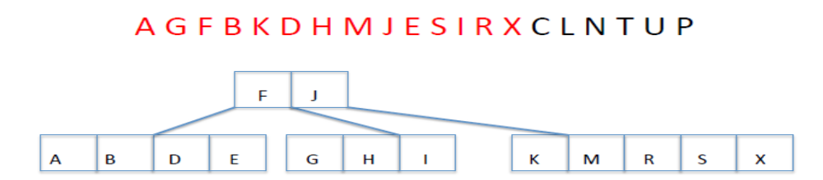
B-Tree construction

Slide 8
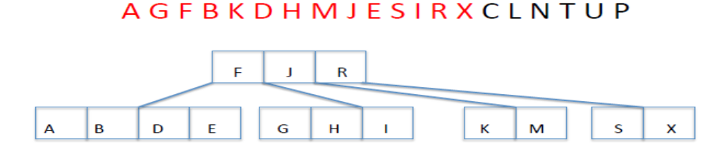
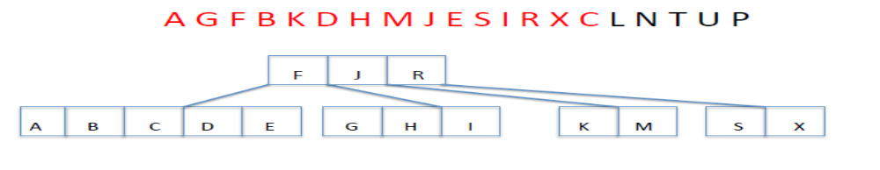
B-Tree construction

Slide 9
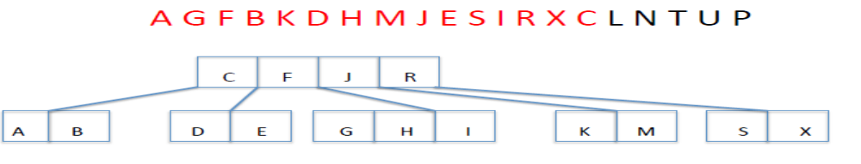
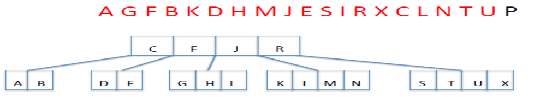
B-Tree construction

Slide 10
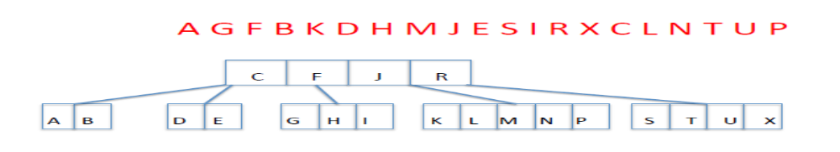
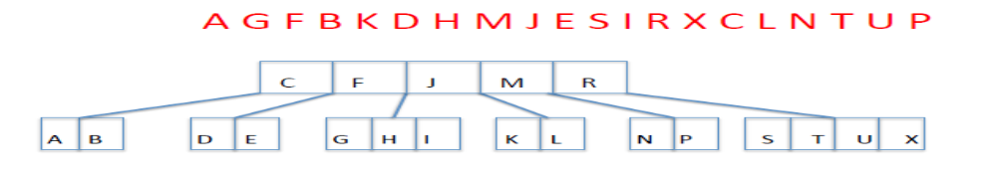
B-Tree construction

Slide 11
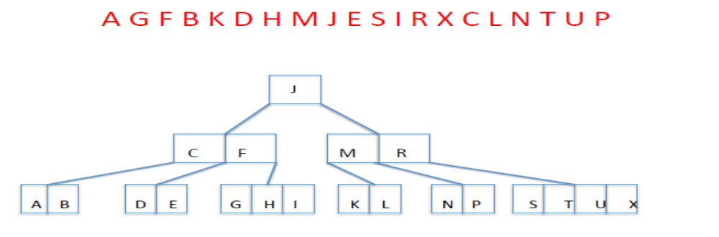
B-Tree construction

